Slide 1
Arrays and Lists
Mack 2023
Notes:
Last updated: 10-17-2022

Slide 2
Warm Up

Slide 3
Make a prediction
Starter activity
1 2 3 | words = ["house","mountain","sheep"] print(words[2])
Questions .
What will be the output of print, when this program is executed?
mountain
sheep
house, mountain
u
1
▹
2
3
4
Why? .
The index location of sheep is 2. You will learn more about this today.

Slide 4

Lesson 29: Arrays and lists
Objectives
In this lesson, you will:
Define a data structure
Define a list and an array
Describe the differences between lists and arrays
Use a list in a program
Append to a list
Notes:
Secondary – objectives slides

Slide 5
Activity 1

Slide 6
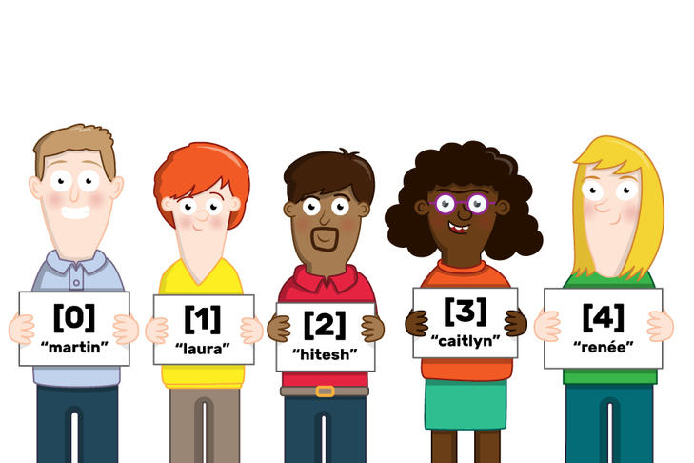
Data structures
Activity 1
In computer science, you often need to manage large amounts of data.
You need to know how this data is stored and the types of operations that you can perform on it.
Data structures are used to store data in an organised and accessible way.
Notes:
Image from Raspberry Pi Foundation Futurelearn course

Slide 7
Data structures
Activity 1
Data structures can be static or dynamic.
Static data structures reserve memory locations for a set amount of data. Their size cannot change.
Dynamic data structures are more flexible. The memory capacity is not fixed.
Notes:
Image from Raspberry Pi Foundation Futurelearn course

Slide 8
Array
Activity 1
An array holds multiple items under one name.
An array is a static data structure.
An array is fixed in size and can only contain data of the same type.
The contents can be changed, but items cannot be added or deleted.
The structure must remain fixed.
digits = [0, 1, 2, 3, 4, 5, 6, 7, 8, 9]

Slide 9
List
Activity 1
A list is often used as a dynamic data structure.
The size of a list can change. It can also contain data of different types.
This means that you can add and delete items as well as perform other operations on a list that are different to an array.
player = ["Sam", "Turner", 22]

Slide 10
Arrays and lists in Python
Activity 1
In Python a list is defined as you see here in this example.
A list is dynamic and can be changed. You can perform many types of operations on a list in Python, and you will explore these over the next few lessons.
1 | words = ["house","mountain","sheep"]

Slide 11
Arrays and lists in Python
Activity 1
In Python, you can use a list as an array if you need to.
You just make sure that:
Each element is of the same data type
You don’t add or delete items from the list
1 | words = ["house","mountain","sheep"]

Slide 12
Activity 1
A list of days
1
2
3
4
days = ["Monday", "Tuesday",
"Wednesday", "Thursday",
"Friday", "Saturday",
"Sunday"]
Here is a list that is used to store the days of the week.
In this example, the list items are string literals (i.e. pieces of text), so they need to be in quotation marks.

Slide 13
Activity 1
A list of days
1
2
3
4
days = ["Monday", "Tuesday",
"Wednesday", "Thursday",
"Friday", "Saturday",
"Sunday"]
days
0 | "Monday"
1 | "Tuesday"
2 | "Wednesday"
3 | "Thursday"
4 | "Friday"
5 | "Saturday"
6 | "Sunday"
When the program is executed, this is what the list will look like in memory.

Slide 14

Activity 1
A list of days
1
2
3
4
days = ["Monday", "Tuesday",
"Wednesday", "Thursday",
"Friday", "Saturday",
"Sunday"]
days
Note: List item numbering starts from 0 (zero-based).
0 | "Monday"
1 | "Tuesday"
2 | "Wednesday"
3 | "Thursday"
4 | "Friday"
5 | "Saturday"
6 | "Sunday"
Each item has a unique index, denoting its position in the list.

Slide 15
Activity 1
A number for a day
1
2
3
4
5
days = ["Monday", "Tuesday",
"Wednesday", "Thursday",
"Friday", "Saturday",
"Sunday"]
print(days[0])
days
0 | "Monday"
1 | "Tuesday"
2 | "Wednesday"
3 | "Thursday"
4 | "Friday"
5 | "Saturday"
6 | "Sunday"
When this program is executed, what will be displayed on the screen?
Answer: Monday

Slide 16
Activity 1
A number for a day
1
2
3
4
5
days = ["Monday", "Tuesday",
"Wednesday", "Thursday",
"Friday", "Saturday",
"Sunday"]
print(days[1])
days
0 | "Monday"
1 | "Tuesday"
2 | "Wednesday"
3 | "Thursday"
4 | "Friday"
5 | "Saturday"
6 | "Sunday"
When this program is executed, what will be displayed on the screen?
Answer: Tuesday

Slide 17
Activity 1
A number for a day
1
2
3
4
5
days = ["Monday", "Tuesday",
"Wednesday", "Thursday",
"Friday", "Saturday",
"Sunday"]
print(days[4])
days
0 | "Monday"
1 | "Tuesday"
2 | "Wednesday"
3 | "Thursday"
4 | "Friday"
5 | "Saturday"
6 | "Sunday"
When this program is executed, what will be displayed on the screen?
Answer: Friday

Slide 18
Activity 1
A number for a day
1
2
3
4
5
days = ["Monday", "Tuesday",
"Wednesday", "Thursday",
"Friday", "Saturday",
"Sunday"]
print(days[7])
days
0 | "Monday"
1 | "Tuesday"
2 | "Wednesday"
3 | "Thursday"
4 | "Friday"
5 | "Saturday"
6 | "Sunday"
When this program is executed, what will be displayed on the screen?
Answer: An IndexError will occur.

Slide 19
Activity 1
A number for a day
1
2
3
4
5
6
days = ["Monday", "Tuesday",
"Wednesday", "Thursday",
"Friday", "Saturday",
"Sunday"]
day = 3
print(days[day])
days
day
0 | "Monday"
1 | "Tuesday"
2 | "Wednesday"
3 | "Thursday"
4 | "Friday"
5 | "Saturday"
6 | "Sunday"
3
Expressions can be used to access item lists (as long as they evaluate to an integer).

Slide 20
Activity 1
A number for a day
1
2
3
4
5
6
days = ["Monday", "Tuesday",
"Wednesday", "Thursday",
"Friday", "Saturday",
"Sunday"]
day = 3
print(days[day])
days
day
0 | "Monday"
1 | "Tuesday"
2 | "Wednesday"
3 | "Thursday"
4 | "Friday"
5 | "Saturday"
6 | "Sunday"
3
3
When this program is executed, what will be displayed on the screen?
Answer: Thursday

Slide 21
Activity 1
A number for a day
1
2
3
4
5
6
days = ["Monday", "Tuesday",
"Wednesday", "Thursday",
"Friday", "Saturday",
"Sunday"]
day = 3
print(days[day-1])
days
day
0 | "Monday"
1 | "Tuesday"
2 | "Wednesday"
3 | "Thursday"
4 | "Friday"
5 | "Saturday"
6 | "Sunday"
3
2
When this program is executed, what will be displayed on the screen?
Answer: Wednesday

Slide 22
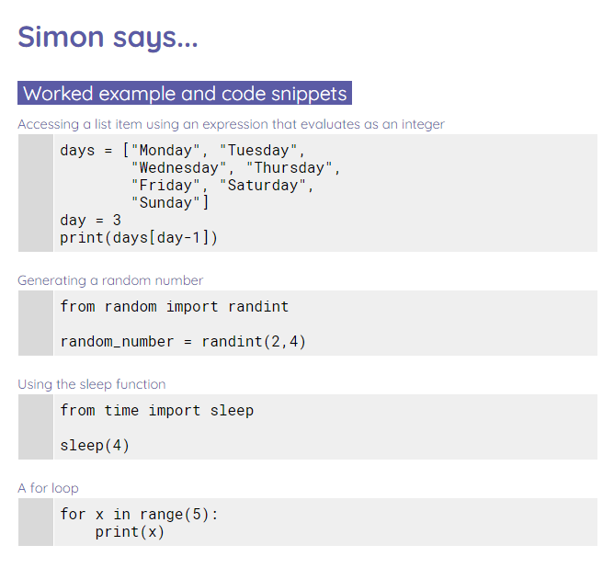
Simon says...
Activity 1
Complete the worksheet to use a list in programs.

Slide 23
Activity 2

Slide 24
Performing operations on lists
Activity 2
Question .
Are lists static or dynamic?
Answer .
Dynamic

Slide 25
Performing operations on lists
Activity 2
Question .
What makes a list dynamic?
Answer .
You can:
Add/delete items
Use different data types

Slide 26
Appending to a list
Activity 2
As lists are dynamic, you can add new items to them during the execution of your programs.
Adding a new item to the end of a list is known as appending the item to the list.

Slide 27
Appending to a list
Activity 2
Here is an empty shopping list.
1 | shopping = []

Slide 28
Appending to a list
Activity 2
You can add new items to the end of the shopping list by using the append operation.
1 2 3 | shopping = [] shopping.append("Bread")

Slide 29
Appending to a list
Activity 2
When you print this list, you can see that first it is empty and then it holds the item bread
1 2 3 4 5 6 7 | shopping = [] print(shopping) shopping.append("bread") print(shopping)
 | [] ['bread'] >>>

Slide 30
Appending to a list
Activity 2
If you add another item, it will be added to the end of the list.
1 2 3 4 5 6 7 8 9 10 11 | shopping = [] print(shopping) shopping.append("bread") print(shopping) shopping.append("cheese") print(shopping)
 | [] ['bread'] ['bread', 'cheese'] >>>

Slide 31
Removing an item from a list
Activity 2
You can also remove items from a list using the remove operator.
You can see that at first, the list contains bread, then the item bread is removed from the list.
1 2 3 4 5 6 7 | shopping = ["bread", "cheese", "milk"] print(shopping) shopping.remove("bread") print(shopping)
 | ['bread', 'cheese', 'milk'] ['cheese', 'milk'] >>>

Slide 32
Removing an item from a list
Activity 2
Question .
After bread is removed from the list, which index location holds the value cheese?
1 2 3 4 5 6 7 | shopping = ["bread", "cheese", "milk"] print(shopping) shopping.remove("bread") print(shopping)
 | ['bread', 'cheese', 'milk'] ['cheese', 'milk'] >>>

Slide 33
Removing an item from a list
Activity 2
Question .
After bread is removed from the list, which index location holds the value cheese?
Answer .
0
The index refers to the position in the list and is not a direct link to the value held in it.
1 2 3 4 5 6 7 | shopping = ["bread", "cheese", "milk"] print(shopping) shopping.remove("bread") print(shopping)
 | ['bread', 'cheese', 'milk'] ['cheese', 'milk'] >>>

Slide 34
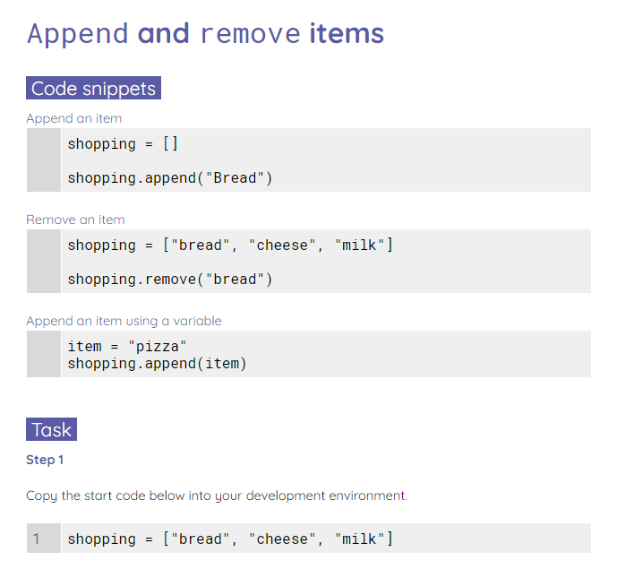
Appending and removing activity
Activity 2
Complete the worksheet to practise appending and removing items from a list.

Slide 35
Activity 3

Slide 36
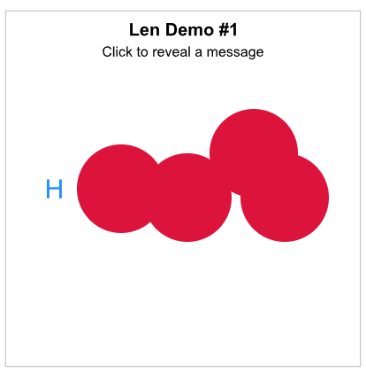
Traversing a List With Len and Range
Activity 3
Read the Traversing a List With Len and Range section.

Slide 37

Traversing a List With Len and Range
Activity 3
Complete 3 pts of exercises!

Slide 38
Wrap Up

Slide 39
Wrap Up
List methods
ncce.io/py-doc-lists
There are many operations you can perform on lists and their items.
Some examples
list.append(item) add item at end of list
list.insert(index, item) add item at index
list.pop(index) remove item at index
list.remove(item) remove item
list.index(item) search for index of item
list.count(item) get occurrences of item
list.reverse() reverse list
list.sort() sort list
numbers.append(42)
cities.insert(2, "Oslo")
last = values.pop()
countries.remove("Japan")
where = planets.index("Mars")
nb_the = words.count("the")
values.reverse()
names.sort()

Slide 40
Next lesson
Summary
In this lesson, you…
Learnt about data structures, lists, and arrays
Learnt how to use lists in your programs
Learnt how to append and remove items from a list
Next lesson, you will…
Manipulate a list and traverse elements in a list

